Slide 1

LIVE FORUM GITHUB
Introduction of Machine Learning

Slide 2

Geophysics
Machine Learning

Slide 3

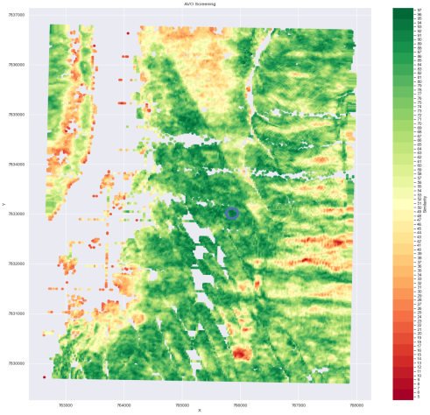
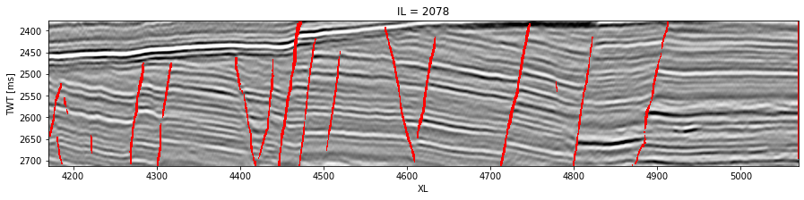
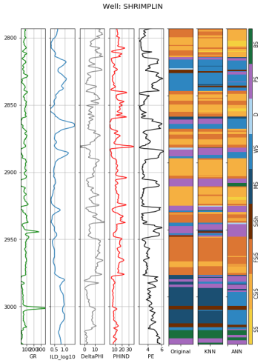
HADYAN
PRATAMA
+62-812-7034-9214
hadyan_pratama@rocketmail.com
https://hpratama.github.io/Hadyan_Portfolio
Geophysics | Machine Learning

Slide 4



OUTLINE
BASIC
GITHUB
BASIC
MACHINE LEARNING
APLIKASI
MACHINE LEARNING

Slide 5
BASIC
GITHUB

Slide 6

BASIC
GITHUB

Slide 7

BASIC
GITHUB

Slide 8
“ Software yang dapat melakukan VCS
BASIC
GIT
VCS (Version Control System)
- Sistem pengontrol revisi

Slide 9

Problems?
BASIC
GIT

Slide 10
Problems?
BASIC
GIT
Mencatat setiap perubahan
Commit

Slide 11

Problems?
BASIC
GIT

Slide 12


BASIC
GITHUB
Website berbasis cloud untuk
Menyimpan dan mengelola
Project git

Slide 13
BASIC
GITHUB
“instagram-nya para
programmer

Slide 14


Slide 15
BASIC
MACHINE LEARNING

Slide 16
ARTIFICIAL INTELLIGENCE
MACHINE LEARNING
DEEP LEARNING

Slide 17
Artificial Intelligence VS Machine Learning
Komputer meniru
kemampuan manusia
Kemampuan komputer
Untuk belajar
Diprogram secara
eksplisit
Tidak diprogram
Secara eksplisit

Slide 18

Artificial Intelligence
Meniru kemampuan manusia
Diprogram secara eksplisit
if suhu > 38 °C:
return Demam

Slide 19
Artificial Intelligence
Meniru kemampuan manusia
Diprogram secara eksplisit
Rule
Input Data
Output Data

Slide 20
Machine Learning
Find rules/
pattern
Collection of Data
Memiliki kemampuan belajar
Train test set
Tidak diprogram secara eksplisit
Trained rules
New Data
Output
Validation set

Slide 21
AI
ML

Slide 22


Data Types
Structured
Data
Unstructured
Data

Slide 23
Data Types
Structured
Data
Unstructured
Data
Machine Learning
Deep Learning

Slide 24
AI
ML
DL

Slide 25
ARTIFICIAL INTELLIGENCE
MACHINE LEARNING
DEEP LEARNING

Slide 26
ARTIFICIAL INTELLIGENCE
MACHINE LEARNING
DEEP LEARNING

Slide 27
Supervised
Learning
Label
MACHINE
LEARNING
Unlabel
Unsupervised
Learning
Reinforcement
Learning

Slide 28
Regression
Supervised
Learning
Classification
Label
MACHINE
LEARNING
Unlabel
Unsupervised
Learning
Reinforcement
Learning

Slide 29
Regression
Prediksi harga rumah
berdasarakan luas tanah
Harga
Luas Tanah

Slide 30
Classification
Prediksi jenis kelamin
Berdasarkan tinggi badan dan ukuran sepatu
Tinggi Badan
Ukuran Sepatu

Slide 31
Classification
Prediksi jenis kelamin
Berdasarkan tinggi badan dan ukuran sepatu
Tinggi Badan
Laki-laki
Perempuan
Ukuran Sepatu

Slide 32
Classification
Prediksi jenis kelamin
Berdasarkan tinggi badan dan ukuran sepatu
Tinggi Badan
Ukuran Sepatu

Slide 33
K Nearest Neighbor
Tinggi Badan
Laki-laki
Perempuan
Ukuran Sepatu

Slide 34
APLIKASI
MACHINE LEARNING

Slide 35
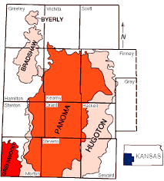
Facies Classification with KNN

Slide 36
Train and Test Set
Validation Set
'SHRIMPLIN‘
'SHANKLE‘
'LUKE G U'
'CROSS H CATTLE‘
’NOLAN‘
'Recruit F9',
'NEWBY‘
'CHURCHMAN BIBLE'
‘STUART’
‘CRAWFORD’

Slide 37
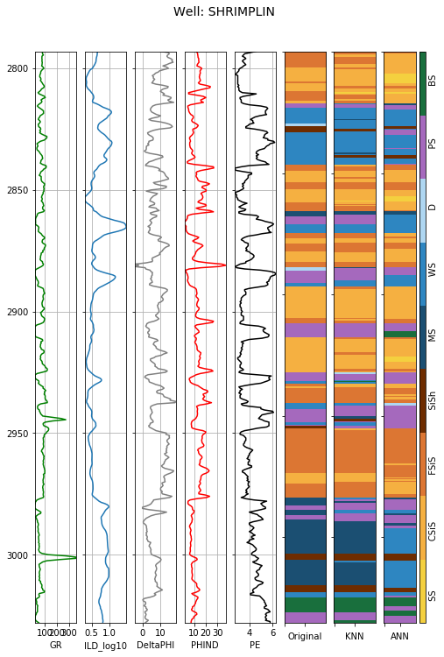

Input
Output

Slide 38
“All models are wrong,
some models are useful”
George Box
www.ezygeo.com
@ezygeo.ai

